Slide 1

Intro to object-oriented programming
Chapter 1

Slide 2
What is Python?
Python is a computer programming language. Or, in other words, a vocabulary and set of grammatical rules for instructing a computer to perform tasks. Its original creator, Guido van Rossum, named it after the BBC television show ‘Monty Python’s Flying Circus.’ Hence, you’ll find that Python books, code examples, and documentation sometimes contain references to this television show.
Python is considered easy to learn, and it’s designed around a set of clearly defined principles (the Zen of Python) that encourage Python core developers to make a language that is unambiguous and easy to use.

Slide 3
What is python used for?
People use Python in many places. Its rich base library makes it excellent for all kinds of little helper scripts. But it scales just as well to large systems. To illustrate, YouTube’s original creators used Python for the most part!
You can use Python to automate tasks, perform calculations, create user interfaces, create website backends, access databases, download information from the Internet, etc. It’s a versatile language that is easy to learn and write, and although perfect for beginning programmers, is just as useful and powerful for seasoned professionals.
Python is extremely popular in a quickly growing field of expertise called data science. Many data scientists use Python for their day-to-day work.

Slide 4
Python’s popularity
It’s hard to measure the popularity of programming languages, and there are many different top lists and ranking systems out there. As an example, Python has been second on a well-known list of popular programming languages since January 2021. Due to its stronghold as a web development language, Javascript is often number one. This is linked to the fact that you have little to no choice regarding browser languages.
Python’s popularity is a great advantage. There are vast amounts of tutorials, books, Python courses, sample code, and help available. Python is here to stay, so if you want to learn Python: it’s a safe bet! Python jobs are ranking high on the pay scale.

Slide 5
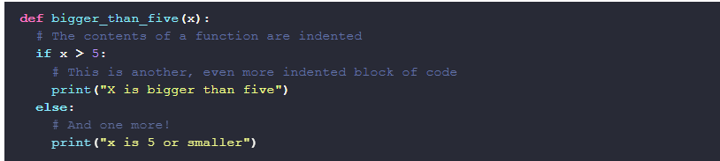
Python’s major features
It’s easy to read and write
One of Python’s most notable features is the way it enforces the use of indentation for readability. Without proper indentation, your code won’t even run. We need to indent all code blocks in Python to the same level. Here’s an example of this at work at the bottom of this text
Because indentation is required, the Python language does not need curly braces to group code blocks like Java, C, and C#. This fact alone removes a lot of clutter and symbols from your code. Although subjective, people generally agree that it makes Python easier on the eyes.

Slide 6
You don’t need to compile your programs manually
Many languages require a manual compilation step before you can run your program, while other languages are so-called interpreted languages: they can be run directly by the interpreter. Python is somewhere in between these two worlds.
When you create a Python program, you can run it directly without a manual compilation step. This is the case with all interpreted languages, and that’s why most people will tell you it is an interpreted language.
However, internally Python compiles your code into lower-level code called bytecode. This code is not specific to a system architecture (like Intel vs. ARM), but it is faster to read and parse than plain text files.

Slide 7
You don’t need to compile your programs manually
In some situations, this bytecode is cached on disk in files ending with the *.pyc extension. But when used as a scripting language, Python won’t cache the bytecode. To us, it doesn’t matter. We can run our code directly without worrying about bytecode since Python handles it all automatically. This has several advantages:
You can write your code in a text editor and execute it directly. No additional steps like compilation and linking are necessary.
Because it’s plain text, you can simply open a program and inspect its contents. In contrast, compiled code is not human-readable. You would have to look up the source code (if it’s available at all).
It is platform-independent. Your code will work as long as the platform has a Python interpreter. Compiled code often ties itself to a specific platform, like Windows and Linux, and specific processor architecture, like Intel or ARM (unless it gets compiled to intermediate bytecode, like with Java and .NET).
Some of these advantages can also be a disadvantage. As already mentioned, interpreted languages are not high-performance languages. Also, the fact that the source code is easy to read and modify is not an advantage to vendors that want to protect their copyright.

Slide 8


Dynamically typed
Another advantage of interpreted languages is that it opens the door to dynamic typing. What does that mean? I’ll demonstrate it with some simple code.
Here are a few variable declarations in Java:
In a strongly typed language, you need to specify the exact type of each variable, like String, int, and float.
Now let’s look at Python variables. In Python, we can do exactly the same without types:

Slide 9
Dynamically typed
As you can see, the Python variant is a lot cleaner and easier on the eyes, while the variable type is still obvious: we can see clearly that 37 is a whole number, and 1250.70 is a floating-point number. And Python can see this too. When running this code, Python dynamically finds out the type of our variables. Say, for example, I’d like to know my yearly income by multiplying my salary by 12. I’d need to do the following:
Python will look at my_salary, see that it is a floating-point value, and perform the math
Dynamic typing has many advantages. In general, it makes it easier to get started quickly. Some will tell you that it’s more error-prone, and perhaps it is. A strongly typed language like Java won’t compile when there’s a type error. Python will probably run your code but complain while running it, or worse: the output will be unexpected. It is my experience that it doesn’t happen that often.

Slide 10
Garbage collection
Python has the concept of variables. A variable can store any value, like a number, text string, or even bigger objects.
Each variable you declare takes up space in your computer’s memory. This can add up quickly, especially when you create programs that run for a long time. So you need a way to clean up variables you don’t use anymore.
In some languages, you need to perform this cleanup explicitly. This is prone to a type of error called a memory leak. If you make a little mistake and forget to clean up, your software will slowly eat up available memory. Lucky for us, Python’s garbage collector automatically cleans up unused variables!
I’m not going into the nitty-gritty details here, but you can rest assured that Python will do a perfect job and will never accidentally clean up a variable you still need.

Slide 11
Python history
In 1987, Guido van Rossum worked on a big distributed operating system at the CWI, a national research institute for mathematics and computer science in the Netherlands. Within that project, he had some freedom to work on side projects. Armed with the knowledge and experience he had built up in the years before, working on a computer language called ABC, he started writing the Python programming language.
He decided that you should be able to extend the language in two ways: by writing Python modules or by writing a module entirely in C. It was a success because his CWI colleagues, the users, and Guido himself immediately started writing their own extension modules.
The extension modules let you do all sorts of things. Just a small selection of modules that exist today:
graphics libraries,
data processing and data science libraries,
libraries to work with all sorts of file formats (like JSON, YAML),
communicate over the network
build websites and website backends
… and so on

Slide 12
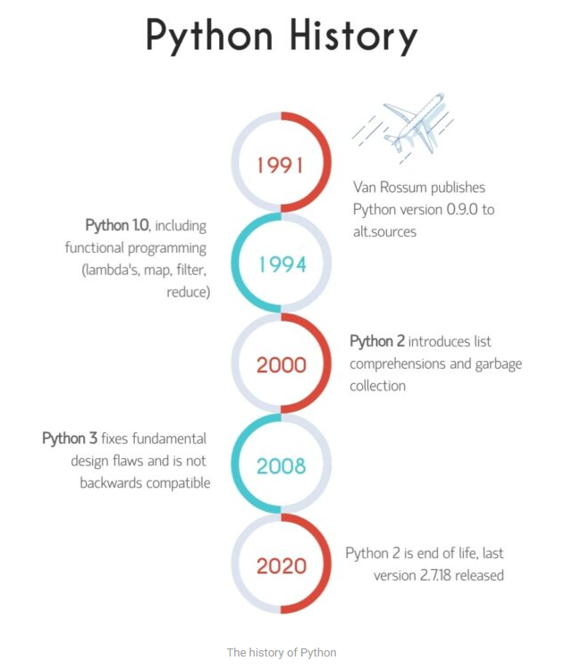

Slide 13
Python 2 vs python 3
As you can see from the Python history timeline, Python 2 and 3 have been developed and maintained side by side for an extended period.
The primary reason is that Python 3 code is not entirely backward compatible with Python 2 code. This incompatibility caused a prolonged adoption rate. Many people were happy with version 2 and didn’t see much reason to upgrade. On top of that, Python 3 was initially slower than Python 2.
As Python 3 kept improving and receiving new features, eventually, it started to take off.

Slide 14
Let’s start programming!
Open up the terminal, type in python (python3) to access Python 3, type number 10 and press ENTER
One rule to remember is REPL (Read-Evaluate-Print-Loop):
Read: Python reads 10
Evaluate: Python evaluates this input and decides it is a number
Print: it prints out what was evaluated
Loop: and it’s ready for the next input
Next, how would you add another 10 and get 20?

Slide 15
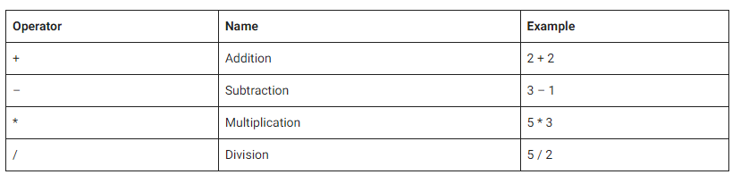
Arithmetic operators

Slide 16
Operator precedence
Operator precedence, the order in which Python processes the operators and numbers, is somewhat similar to regular math.
For example, multiplication and division come before addition and subtraction.
However, in Python multiplication and division have the same precedence, so the order matters too. E.g., 2 * 2 / 8 = 0.5 , while 2 / 2 * 8 = 8.0. If in doubt, you can always use parentheses.

Slide 17
What is a Python variable?
Variable - used to store information that can be referenced later on.
So a variable is what we use to name the result of, for example, a calculation we make. Or, in other words, we can assign the result of that calculation to a variable. We can create an unlimited amount of variables; we just have to make sure we give them unique names.

Slide 18
Declaring a Python variable - Variable naming
In the example, we picked the general name result, but you can choose any name you deem appropriate. As a general rule, always pick a variable name that best describes its contents. This practice makes your code more readable and easy to understand.
If we were calculating the total price of a shopping cart here, for example, a good name would be shopping_cart_total.
Expression – anything that Python can evaluate to a value

Slide 19
Variable type
A value assigned to a variable does not have to be a number, by the way. Python has several data types besides numbers, and they can all be the result (the value) of an expression. One such data type is the Python string. But there are others too, like booleans and tuples.
Python has a built-in function called type(), which we can use to determine a variable or expression type

Slide 20
Valid Python variable names
Some characters are not allowed in a variable name; there are a few rules we need to abide by. Let’s start with the complete list of valid characters that can appear in a variable name:
Lowercase and uppercase letters: a-z and A-Z
Numbers: 0-9
Underscores: _
Additionally, there are these two rules:
Variable names must start with a letter or the underscore character and can not start with a number.
Names are case-sensitive

Slide 21
Valid Python variable names
Here are some valid variable names:
name_1,
name_2,
_database_connection
These are invalid names:
1tomany (don’t start with a number)
my-number (- is not allowed)
my number (spaces are not allowed)
And these variables are not the same, due to case sensitivity:
cartTotal
carttotal

Slide 22
Python String: Working With Text
String - A string in Python is a sequence of characters
In even simpler terms, a string is a piece of text. Strings are not just a Python thing. It’s a well-known term in the field of computer science and means the same thing in most other languages as well

Slide 23
Single or double quotes?
Note that these are not two single quotes next to each other. The character is often found next to the enter key on your keyboard (US keyboard layout) or on the 2 key (UK layout). It might differ for other countries. You need to press shift together with this key to get a double quote.
As you can see from its answer, Python itself seems to prefer single quotes. It looks clearer, and Python tries to be as clear and well-readable as possible. So why does it support both? It’s because it allows you to use strings that contain a quote.

Slide 24
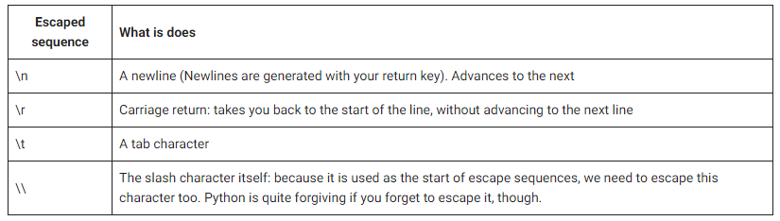
Escaping and multiline strings
You can escape a special character, like a quote, with a backward slash
Python also has syntax for creating multiline strings using triple quotes. By this, I mean three double quotes or three single quotes
The following table lists a couple of the most common escape sequences you will encounter:

Slide 25
String operations
Strings come with several handy, built-in operations you can execute
Getting the string length: len()
Split a string: .split(‘’)
A common use case is to split on whitespace. The problem is that whitespace can be a lot of things. Three common ones that you probably know already are:
space characters
tabs
newlines
But there are many more, and to make it even more complicated, whitespace doesn’t mean just one of these characters but can also be a whole sequence of them. E.g., three consecutive spaces and a tab character form one piece of whitespace.

Slide 26
String operations
Replace parts of a string: .replace()
Reversing a string
Chaining calls
Python string formatting with f-strings

Slide 27
Output Data To Your Screen With Python’s print() Function
What is a function? A function is something you can call. It will do something specific for us, and the name often implies what it does. Functions often accept arguments, which they can use to do their specific job.
The Python print() function can print text to our screen. We can feed one or more arguments, and these arguments will be printed on the screen.

Slide 28
Print function
A couple of observations that you might have caught yourself:
Python’s print is called by entering its name followed by parentheses.
The optional arguments are listed between the parentheses, separated by commas.
You can print both numbers and strings. In fact, most data types in Python can be printed.
You can mix argument types, like numbers and strings.
In its most basic form, we can call print without any argument. In this case, it prints an empty new line.
The print() function will convert special characters into something meaningful. E.g., the newline character \n turns into an actual newline, and the tab character \t will get converted into an actual tab.
print() won’t escape strings like the REPL does, because we don’t want to show escaped strings to the users of our software. It’s just a convenience thing the REPL offers us, the programmers.

Slide 29
Python Boolean and Conditional Programming: if.. else
Besides numbers and strings, Python has several other types of data. One of them is the Boolean data type. Booleans are extremely simple: they are either true or false. Booleans, in combination with Boolean operators, make it possible to create conditional programs: programs that decide to do different things, based on certain conditions.

Slide 30
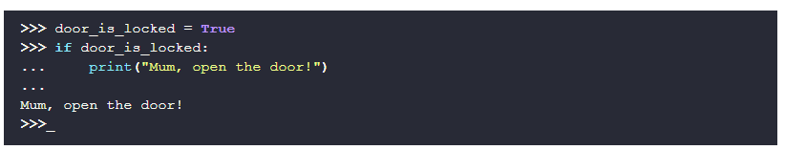
If else example
First, we define a variable called door_is_locked and set it to True. Next, you’ll find an if-statement. This is a so-called conditional statement. It is followed by an expression that can evaluate to either True or False. If the expression evaluates to True, the block of code that follows is executed. If it evaluates to False, it is skipped. Go ahead and change door_is_locked to False to see what happens.
An if can be followed by an optional else block. This block is executed only when the expression evaluates to False. This way, you can run code for both options

Slide 31
Python operators
The ability to use conditions is what makes computers tick; they make your software smart and allow it to change its behavior based on external input. We’ve used True directly so far, but more expressions evaluate to either True or False. These expressions often include a so-called operator.
There are multiple types of operators, and for now, we’ll only look at these:
Comparison operators: they compare two values to each other
Logical operators

Slide 32
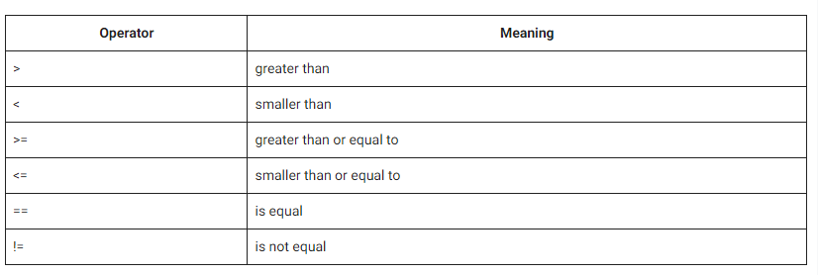
Comparison operators

Slide 33
Comparison oeprators
As can be seen in the examples, these operators work on strings too. Strings are compared in the order of the alphabet, with these added rules:
Uppercase letters are ‘smaller’ than lowercase letters, e.g.: ‘M’ < ‘m’
Digits are smaller than letters: ‘1’ < ‘a’
You’re probably wondering what the logic is behind these rules. Internally, each character has a number in a table. The position in this table determines the order (Unicode)

Slide 34
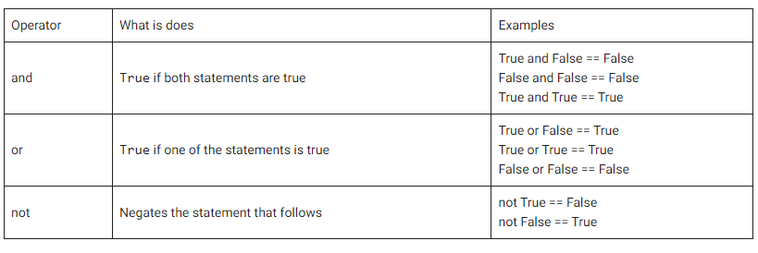
Logical operators
These operators only work on booleans and are used to implement logic.

Slide 35
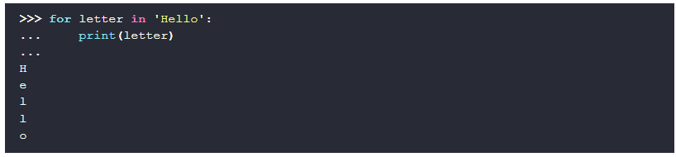
Python For Loop and While Loop
There are two ways to create a loop in Python. Let’s first look at Python’s for-loop. A for-loop iterates over the individual elements of the object you feed it
Iterable - An iterable is an object in Python that can return its members one at a time.

Slide 36
lists
This is the ideal time to look at a new data type: lists.
A Python list can contain zero or more objects. It’s a frequently used data type in Python programming. In other programming languages, there often is no such thing as a list.
Most languages do offer arrays, but arrays can only contain one type of data.

Slide 37
LISTS
A couple of things to note:
we create lists with block quotes.
Its contents are objects of whatever type you like, separated by commas, and they don’t need to be of the same type.
We can access the individual elements of a list manually too.
A list can contain all the types we’ve seen so far: numbers, strings, booleans, and even other lists. Indeed, you can create a list of lists if you want!

Slide 38

Python While-loop
While the for-loop in Python is a bit hard to understand, because of new concepts like iterability and objects, the while loop is actually much simpler!

Slide 39
Infinite loops
Sometimes you want your software to keep running. In such cases, an infinite loop can be of help
With while loops, it’s easy to make a mistake and find yourself caught in an infinite while-loop. This means the expression never evaluates to False for some reason. It happens to the best of us. You can get out of this situation by pressing control + c at the same time

Slide 40
Python Function: The Basics Of Code Reuse
The function is a crucial concept in the world of programming.
Function - A Python function is a named section of a program that performs a specific task and, optionally, returns a value
Functions are the real building blocks of any programming language. We define a Python function with the def keyword.
But before we start doing so, let’s first go over the advantages of functions, and let’s look at some built-in functions that you might already know.

Slide 41
Advantages of using functions
Code reuse - A Python function can be defined once and used many times. So it aids in code reuse: you don’t want to write the same code more than once. Functions are a great way to keep your code short, concise, and readable. By giving a function a well-chosen name, your code will become even more readable because the function name directly explains what will happen. This way, others (or future you) can read your code, and without looking at all of it, understand what it’s doing anyway because of the well-chosen function names.
Parameters - Functions accept a parameter, and you’ll see how this works in a moment. The big advantage here, is that you can alter the function’s behavior by changing the parameter.
Return values - A function can return a value. This value is often the result of some calculation or operation. In fact, a Python function can even return multiple values.

Slide 42
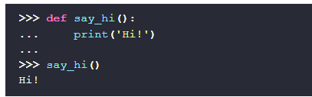
Creating a python function
It’s just a few lines, but a lot is going on. Let’s dissect this:
First of all, we see the keyword def, which is Python’s keyword to define a function.
Next comes our function name, say_hi.
Then we encounter two parentheses, (), which indicate that this function does not accept any parameters (unlike print and len).
We end the line with a colon (:)
And finally, we bump into a feature that sets Python apart from many other programming languages: indentation.

Slide 43
Indentation
Python uses indentation to distinguish blocks of code that belong together. Consecutive lines with equal indentation are part of the same block of code.
To tell Python that the following lines are the body of our function, we need to indent them. You indent lines with the TAB key on your keyboard. In Python, it’s good style to use four spaces for indentation. The entire Python community does so. If you hit the TAB key, the Python interactive shell (REPL) and all decent editors will automatically indent with four spaces.

Slide 44
Python function parameters and arguments
Parameters and arguments - A Python function can have parameters. The values we pass through these parameters are called arguments.

Slide 45
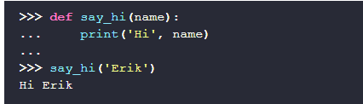
We can make this more interesting by allowing an argument to be passed to our function. Again we define a function with def, but we add a variable name between the parentheses
Our function now accepts a value, which gets assigned to the variable name. We call such variables the parameter, while the actual value we provide (‘Erik’) is called the argument.

Slide 46
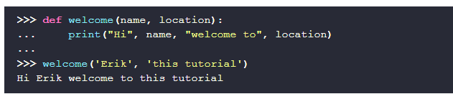
Python function with multiple arguments
Let’s make this even wilder and define a function with multiple arguments
It’s not that hard; you just add more arguments to the function definition, separated by commas.

Slide 47
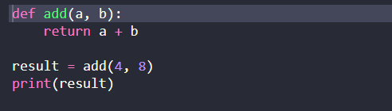
Returning values
So far, our function only printed something and returned nothing. What makes functions a lot more usable is the ability to return a value. Let’s see an example of how a Python function can return a value
As you can see, we use the keyword return to return a value from our function. Functions that return a value can be used everywhere we can use an expression. In the example, we can assign the returned value to the variable result.

Slide 48
Variable scope
The variable name only exists inside our function. We say that the scope of the variable name is limited to the function say_hi, meaning it doesn’t exist outside of this function.
Scope - The visibility of a variable is called scope. The scope defines which parts of your program can see and use a variable.
If we define a variable at the so-called top level of a program, it is visible in all places.

Slide 49
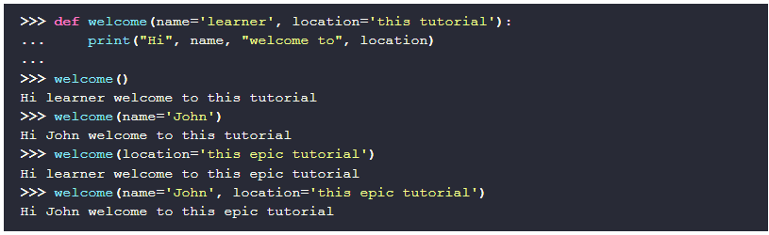
Default values and named parameters
A compelling Python feature is the ability to provide default values for the parameters:

Slide 50
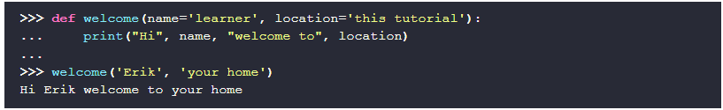
DEFAULT VALUES AND NAMED PARAMETERS
Because our parameters have a default value, you don’t have to fill them in. If you don’t, the default is used. If you do, you override the default with your own value.
Calling Python functions while explicitly naming the parameters differs from what we did up until now. These parameters are called named parameters because we specify both the name and the value instead of just the value. Thanks to these named parameters, the order in which we supply them doesn’t matter. If you think about it, it’s the natural and only way to make default values useful.
If you don’t want to use named parameters, you can. When you rely on position instead of names, you provide what we call positional parameters. The position matters, as can be seen below:

Slide 51
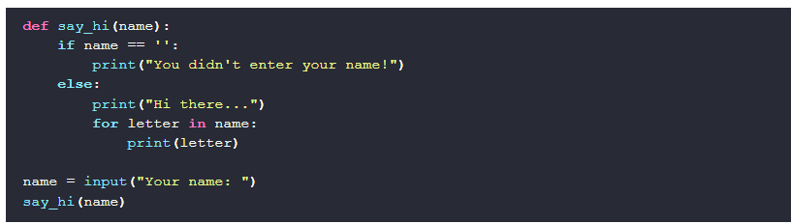
Your First Python Program

